Slide 1

Car Logo Detection
03/06/2024
Group Members:
SINZINKAYO JIMMY JACKSON 2120236014
MOGOS AMAN TESFAY 2120236015
SEMERE BEREKET KIBROM 2120236016
ABERI INNOCENT NYAKWEBA 2120236021
LUWORO PRISCILLA KINONGA 2120236022
IYAMUREMYE AIMABLE 2120236025

Slide 2
Outline
Introduction
Methods
Future Work

Slide 3
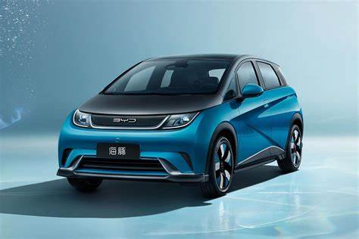


Introduction
Logos are often used in business to distinguish one entity from another and to identify a company's goods and services
Most manufacturers intentionally design brand logos to stand out on the car.
That is, vehicle logos are usually brighter than the body of the vehicle, have well-defined edges, contain a closed shape (circular or rectangular) and that the most interesting portions of logo are around the edges.

Slide 4
Car Logo detection Application
Car logo detection can provide complementary information for vehicle identification in robotic systems
Its recognition also plays an important role in the scenarios where the authenticity of vehicle’s make is doubtful.
The logo detection can be used as an authenticity validation step for this purpose.
Car logo detection can help identify the distribution of different vehicle types (e.g., taxis, rideshare vehicles)
Identification through vehicle logo is a challenging task due to its smaller size.
Logo Size and Resolution
Illumination Variance
Logo Location

Slide 5






Does any one know all this car brands
Tata
HONDA
Brilliance
FAW
Dongfeng

Slide 6
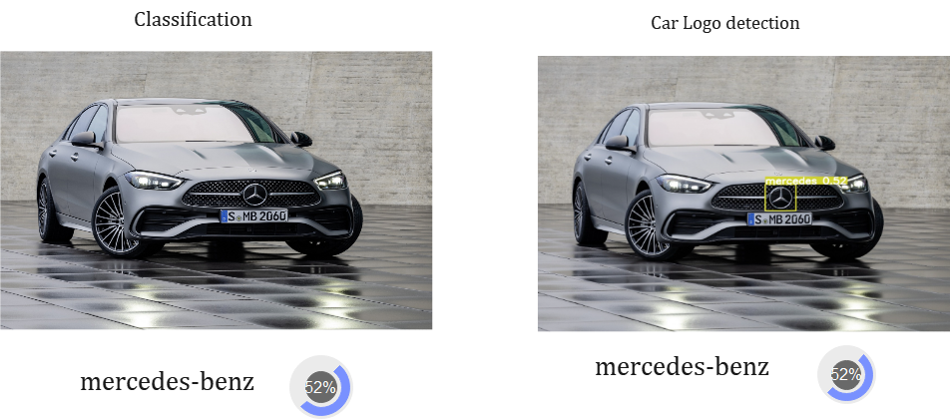
Classification vs Detection

Slide 7
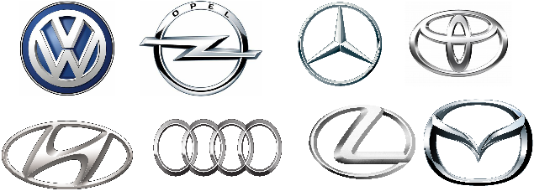

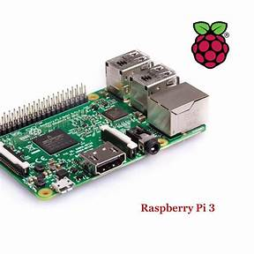





Methods
Collecting Images
Demo 2
Image Augumenation
Demo 1
Data Transfer
YOLO(You Only Look Once)
Evaluate
Deployment

Slide 8
Future Work
Improve Accuracy
Increase the speed / inference time
Add another car logo brands
Add some functionality
Retrieve some information manufactures from google or Baidu website
Text to speech for results

Slide 9
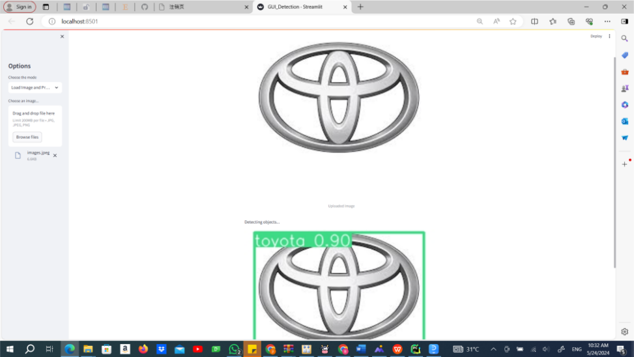
Demo 1:streamlit

Slide 10
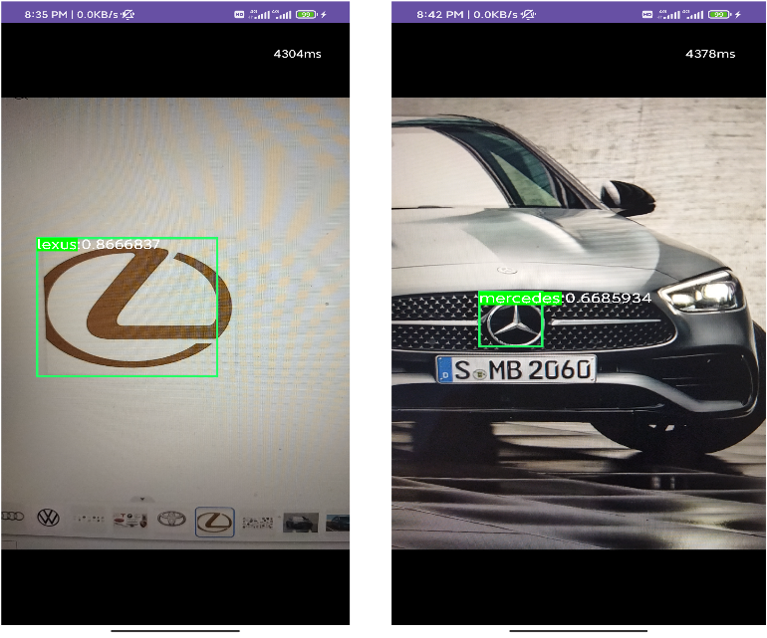
Demo 2 :Android

Slide 11
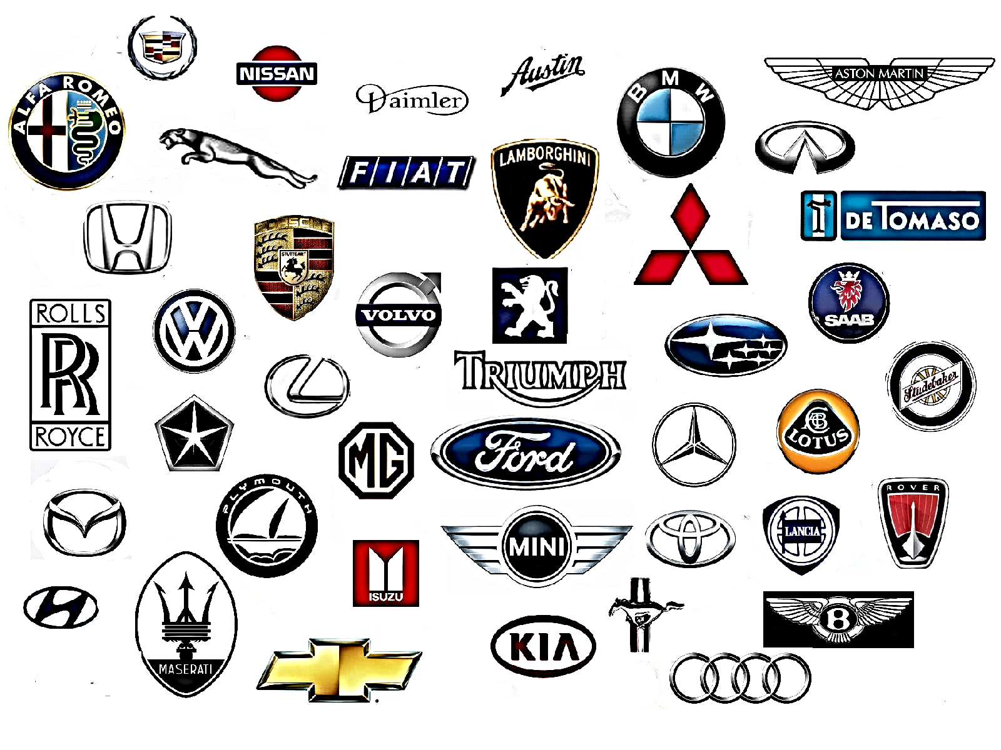
Thank You !! https://github.com/BereketKibrom/CarLogoDetection

